Slide 1


SQUID SIMULATION PROJECT
Author : SIthagu ORINEA
Supervisors: Prof. Doug Butterworth and Dr Susan Holloway

Slide 2
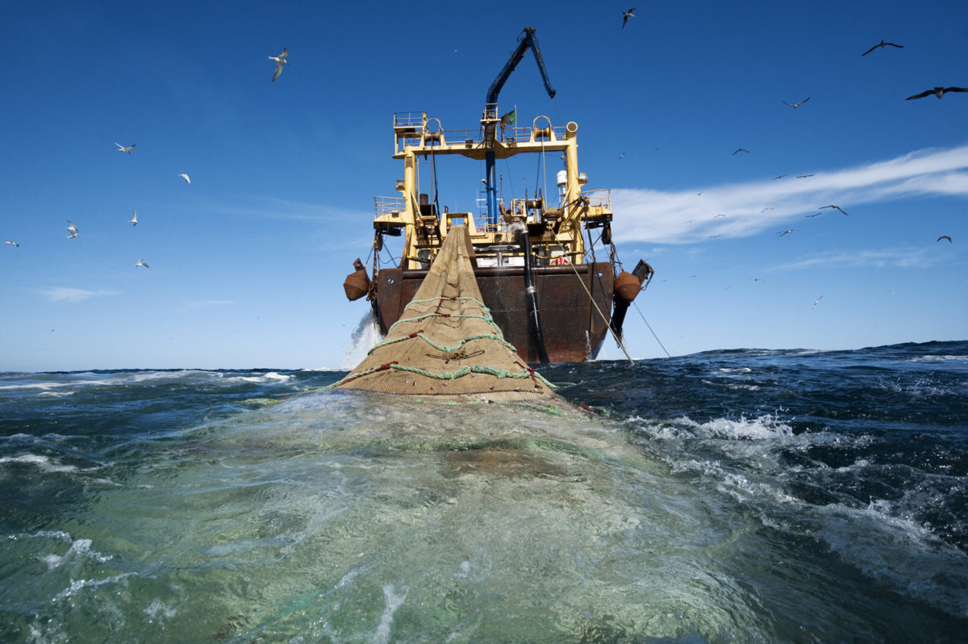
OBEJECTIVE
Acquire squid effectively with minimum risk to the squid population.

Slide 3
Detailed OBJECTIVES
Develop a catch rule with suitable yield.
01
Don’t deplete the squid population.
02
Ensure stability of Catch through out the years.
03

Slide 4
METHOD
Biomass; Catch; Recruitment;
Biomass of following year
Develop a 20-year simulation

Slide 5
METHOD For catch
Biomass
Biomass survey
Catch Rule
Biomass for following year

Slide 6

Proposed Catch rule
Catch_[i] = (Biomass_Survey[i]*0.25) + 0.4

Slide 7
COMPARING CATCH RULES
Average annual Catch
Average Catch Variation
Lowest Biomass of population
The biomass after 20-year simulation.

Slide 8
Comparing CATCH Yield

Slide 9
Comparing Average annual catch variation

Slide 10
Comparing lowest Population BIOMASS

Slide 11
Comparing THE FINAL BIOMASS AFTER SIMULATION

Slide 12
CONCLUSION
Cons
- Low final biomass.
Pros
- Produces satisfactory results across all metrics.

